Slide 1
Map Analysis Project MAP

Slide 2
Summary/Problem statement
Data generated from individual user maps may generally not have much meaning. However, a collection of data generated from multiple users’ maps can provide insight with respect to activity trends or preferences which can then become useful for business purposes.

Slide 3
Summary/Problem statement
This application aims at providing customized functionalities for analyzing collections of data generated from users’ maps and offers insights and/or trends to the end user.

Slide 4
Stakeholders/Actors
Developers
This consists of the development and testing team. This team will also handle the necessary documentation for the application
Clients
Clients could range from private business owners, research organizations or the government

Slide 5
Stakeholders/Actors
Regulators
This will be the appropriate department of government responsible for road networks and transport systems

Slide 6
Development Environments
Anaconda Navigator
Python 3.6 + (programming language)
HTML
QT DESIGNER - GUI

Slide 7
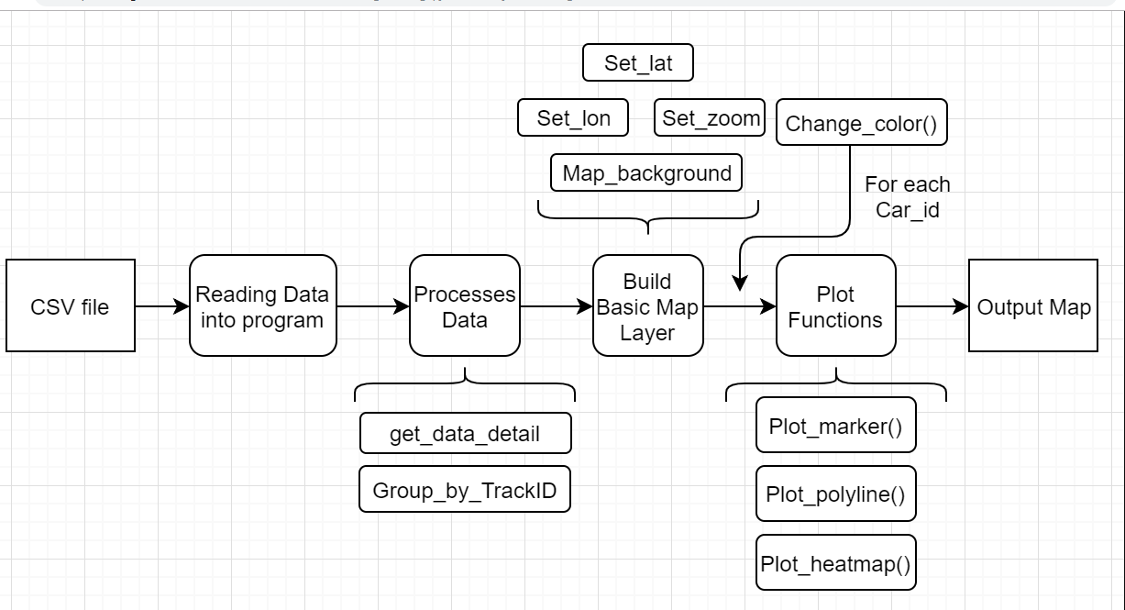
Program Structure

Slide 8
Task Division
The team consists of 3 developers;
Amatya, Prawan
George, Ogungbemile
Zhang, Zhaohe
Each developer writes code for different functions that make up the application as a whole. This approach is well suited for this project and allows for efficient time management.

Slide 9
Individual roles of developers
George Ogungbemile
Sourced for online datasets compatible with geographical information system development.
Handled development of heat map function and graphical user interface
Zhang, Zhaohe
Sourced for optimal libraries compatible with geographical information systems development and determined folium library was best suited for the project.
Handled development of the marker function and graphical user interface

Slide 10
Individual roles of developers
Amatya, Prawan
Provided the overall project idea and scope. Provides guidance with respect to future work and scalability of the application.
Handled initial concepts and general development of the functions related to the map elements including marker, polylines and polygons.

Slide 11
Version control system
We are currently using GITHUB as our central repository. All code versions, updates and changes are pushed to the central repository which can be accessed by each developer.
Individual changes made by each team member is committed with standard change markers to track the identity of the change maker and appropriate time stamps are affixed by the version control system

Slide 12
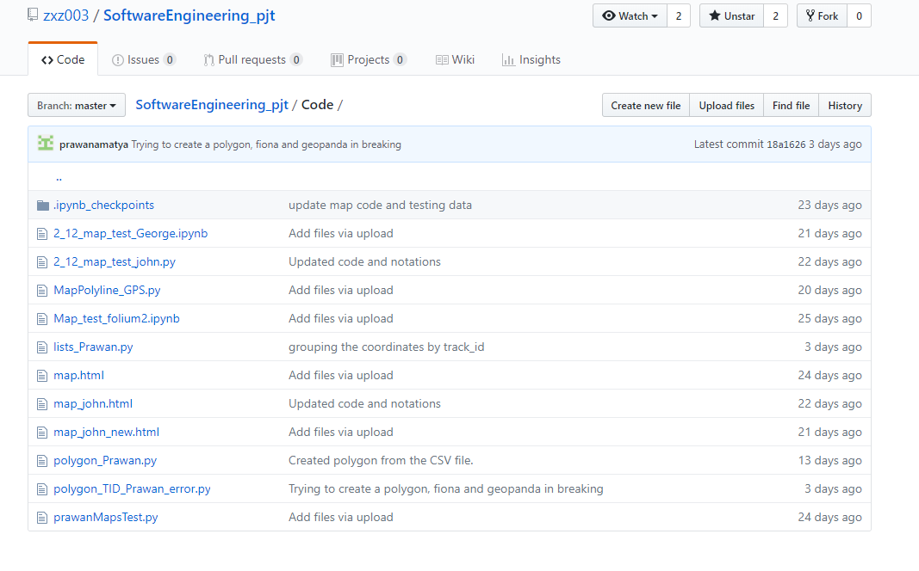
Version control system

Slide 13
Dataset
The datasets to be used for the purpose of experimental development is a collection of 3000 data points with the following attributes that depict a users coordinates and other attributes. The format of the files are csv and the common attributes for each file are as follows;
Longitude
Latitude
Speed

Slide 14
Dataset
Distance
Time
Dataset information
The dataset is composed of two tables. The first table go_track_tracks presents general attributes and each instance has one trajectory that is represented by the table go_track_trackspoints.

Slide 15
Dataset
Attribute Information of each table includes:
1. go_track_tracks.csv: a list of trajectories
id_android - it represents the device used to capture the instance;
speed - it represents the average speed (Km/H)
distance - it represent the total distance (Km)
rating - it is an evaluation parameter. Evaluation the traffic is a way to verify the volunteers perception about the traffic during the travel, in other words,

Slide 16
Dataset
if volunteers move to some place and face traffic jam, maybe they will evaluate 'bad'. (3- good, 2- normal, 1-bad).
rating_bus - it is other evaluation parameter. (1 - The amount of people inside the bus is little, 2 - The bus is not crowded, 3- The bus is crowded.
rating_weather - it is another evaluation parameter. ( 2- sunny, 1- raining).
car_or_bus - (1 - car, 2-bus)
linha - information about the bus that does the pathway

Slide 17
Dataset
2. go_track_trackspoints.csv: localization points of each trajectory
id: unique key to identify each point
latitude: latitude from where the point is
longitude: longitude from where the point is
track_id: identify the trajectory which the point belong
time: datetime when the point was collected (GMT-3)

Slide 18
Application libraries
Folium
Pandas
Numpy
QT Designer

Slide 19
Application libraries(Folium)
Folium makes it easy to visualize data that’s been manipulated in Python on an interactive leaflet map.
It enables both the binding of data to a map for visualizations as well as passing rich vector/raster/HTML visualizations as markers on the map.

Slide 20
Application libraries(Folium)
The library also has a number of built-in tilesets from OpenStreetMap, Mapbox, and Stamen, and supports custom tilesets with Mapbox or Cloudmade API keys.
Folium supports both Image, Video, GeoJSON and TopoJSON overlays.

Slide 21
Application libraries(Pandas)
pandas is an open source, BSD-licensed (Berkley Software Distribution) library providing high performance, easy-to-use data structures and data analysis tools for the Python programming language.

Slide 22
Application libraries(Numpy)
NumPy is the fundamental package for scientific computing with Python. It contains among other things:
a powerful N-dimensional array object
sophisticated (broadcasting) functions
tools for integrating C/C++ and Fortran code
useful linear algebra, Fourier transform, and random number capabilities

Slide 23
Application libraries(Numpy)
Besides its obvious scientific uses, NumPy can also be used as an efficient multi-dimensional container of generic data. Arbitrary data-types can be defined. This allows NumPy to seamlessly and speedily integrate with a wide variety of databases.
NumPy is licensed under the BSD license, enabling reuse with few restrictions

Slide 24
Functions
Heatmap
Marker
Polyline
GUI Functions (Load data, Data Info, BL Setting, Plot All, Quit, Track ID etc)

Slide 25
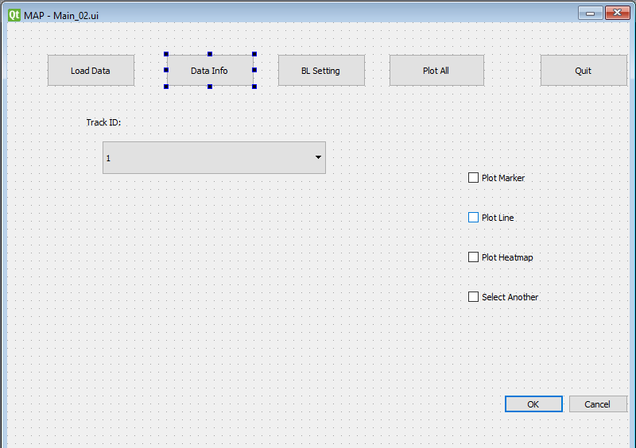
GUI

Slide 26
Functions(HeatMap)
The HeatMap class is a class under the folium.plugins.HeatMap
The plugin creates a heat map layer over a set of specified coordinates.
It is also compatible with HTML representation which allows a HTML rendering of the elements.

Slide 27
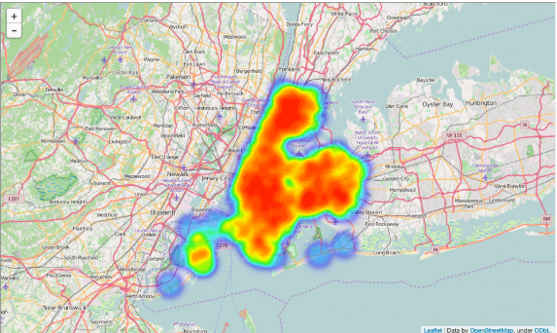
Functions(HeatMap)

Slide 28
Functions(Marker)
The Marker plugin is under the folium.map.Marker
There are numerous marker types, starting with a simple Leaflet style location marker with a popup and tooltip HTML
There is built in support for colors and marker icon types from bootstrap.

Slide 29
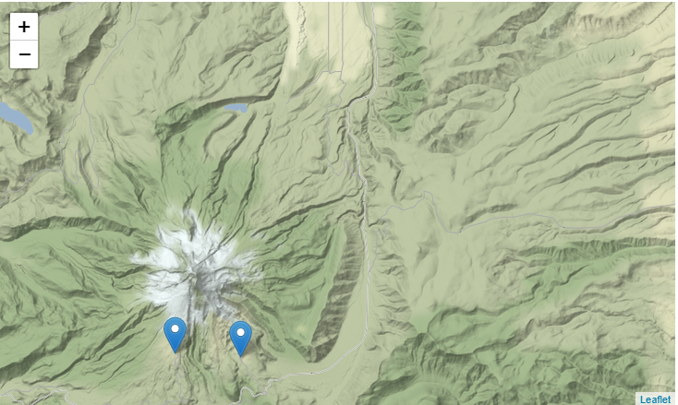
Functions(Marker)

Slide 30
Functions(Polyline)
This is a popular leaflet external plugin under the folium.plugins.AntPath
It is a class for drawing Antpath polyline overlays on a map
It also renders HTML representations of the coordinate elements.

Slide 31
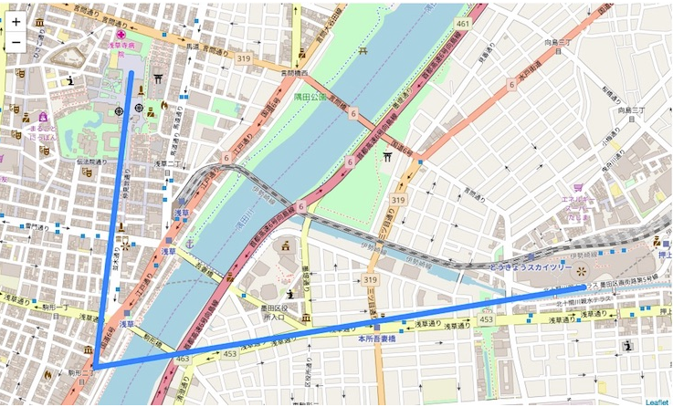
Functions(Polyline)

Slide 32
Future direction of work
Polygon
Generating areas
Advanced data analysis

Slide 33
Questions
? ? ?

